Slide 1

Computer vision 2021 final project - Plant Pathology 2021 FGVC8
Noam Marko & Lidor Amitay
Best Score : 0.786
Submissions : 27

Slide 2


The contest
The main purpose of the contest is to create a model that will be able to study and give accurate “answers” whether the leaves have diseases or not (and if so – what type of disease).

Slide 3
Our solution
The main part of our solution was based on code we’ve written throughout the course (home exercises and lab sessions).
It also includes notebooks from Kaggle which we’ve added to the sources section.
In addition, we used some functions given to us by the course staff.
In this project we predicted diseases for a given leaves images dataset. For this purpose, we used multi - label classification and One-Hot encoding. We used classification models such as resnet34, wide resnet 50 and resnext50.
We wrote the training process that the models used, and then we classified the results by comparing them to the threshold that we decided on after examining the results of the submissions.

Slide 4


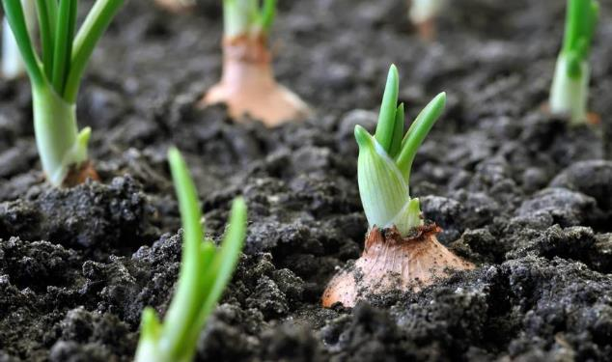
Problems we encountered
Loading of the weights – We had a situation that the weights weren’t uploaded properly to Kaggle (we worked in Colab environment).
GPU limitations – The GPU that was allocated for us each day wasn’t enough for the training we planned at the beginning.

Slide 5
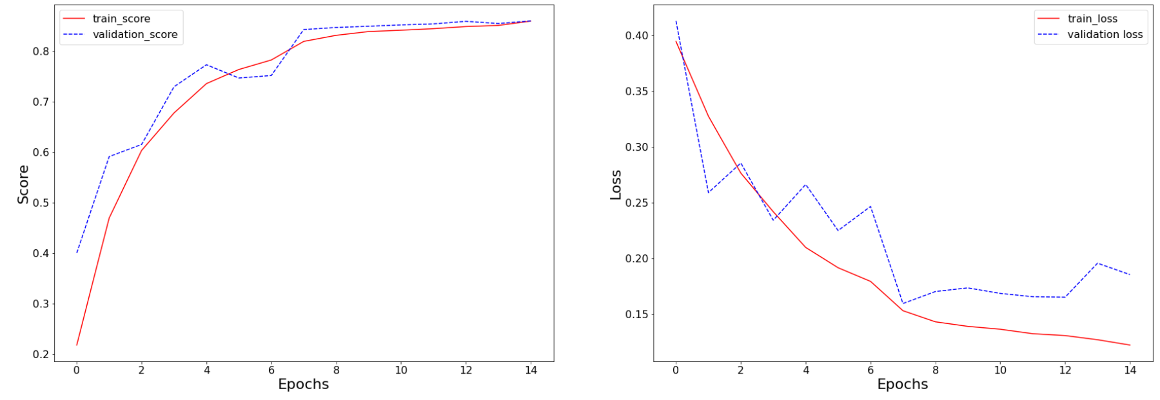
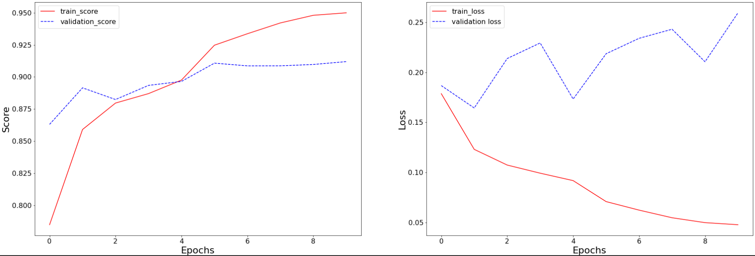
Graphs
Wide resnet pretrained - false 15 epochs :
Wide resnet 50 pretrained – true : 10 epochs

Slide 6
Scheduler
The Scheduler provides several methods to adjust the learning rate based on the number of epochs.
The method we used is called StepLR and it decays the learning rate every number of epochs by multiplying the learning rate with ‘gamma’ parameter.
Parameters:
optimizer (Optimizer) – Wrapped optimizer.
step_size (int) – Period of learning rate decay.
gamma (float) – Multiplicative factor of learning rate decay. Default: 0.1.
last_epoch (int) – The index of last epoch. Default: -1.

Slide 7
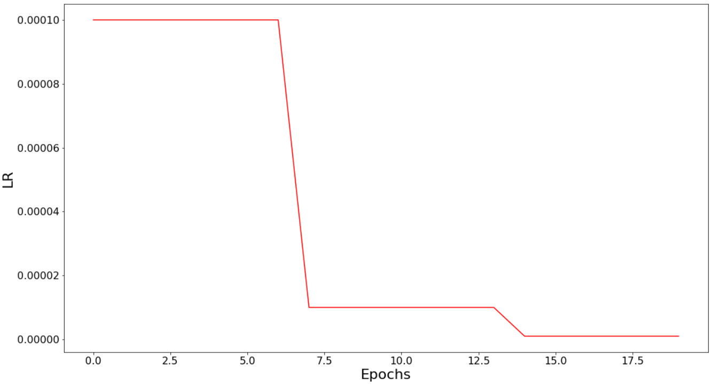
Scheduler

Slide 8
Model comparison

Slide 9


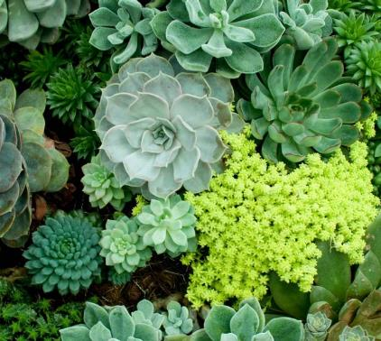

Summary
In conclusion, the wide_resnet50_2 (while pre-trained=True) gave the best disease recognition result.
The reason behind that is probably because of the depth (wide_resnet has 69 million parameters while resnext50 has only 25.5 million parameters), which leads us to the problem with this model – its training process takes the longest time.

Slide 10
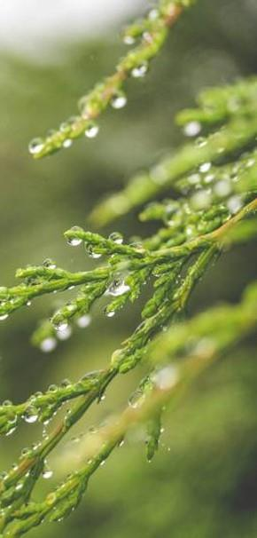

Thank you

